Slide 1
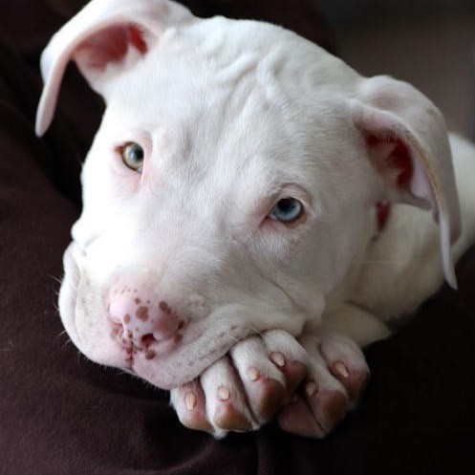
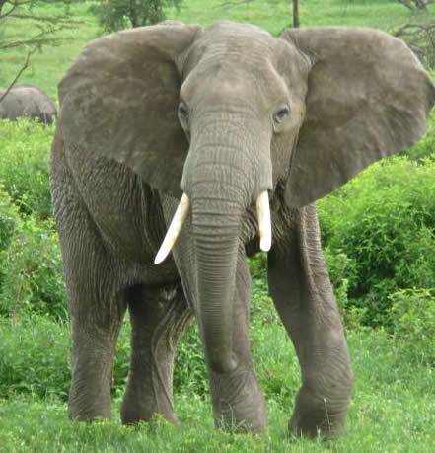
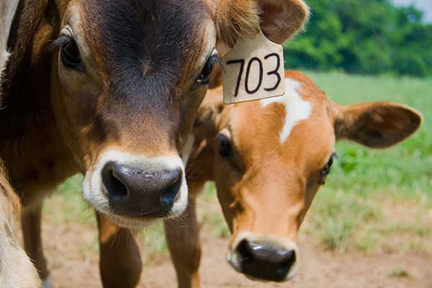
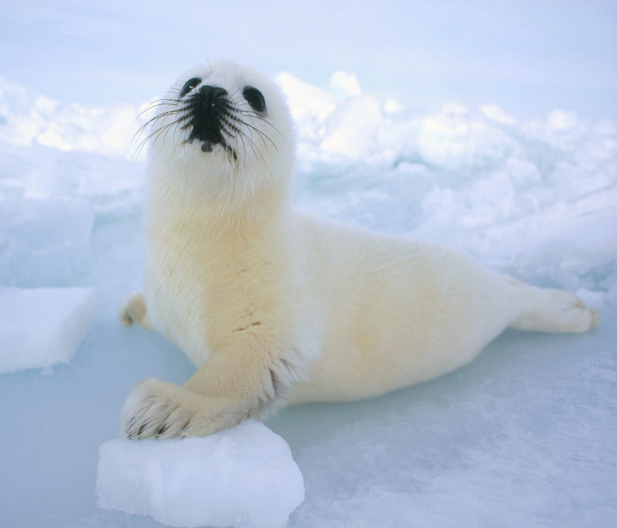
Grassroots 101
Get politically active for animals!

Slide 2
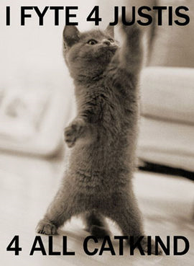
What is grassroots advocacy?
An organized effort by citizens to affect public policy by influencing policy-makers.

Slide 3
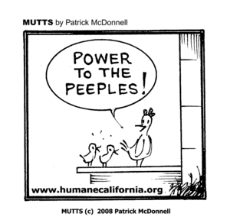
Why work on legislation?
To educate and spread awareness about animal-related issues
Real changes in society and industry occur through changes in legislation
Media coverage can be created, generating public awareness and dialogue
To learn more about your government and be an active citizen!

Slide 4
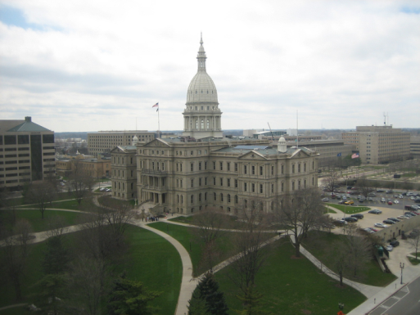
Michigan Legislature
Two elected houses: House (lower) and Senate (upper)
110 House districts
Representatives elected in even-number years; serve 2-year terms
38 Senate districts
Senators elected at same time as governor; serve 4-year terms
MI legislature runs throughout the year
Learn more: http://legislature.mi.gov

Slide 5
Who Represents Me?
Michigan House
Michigan Senate
U.S. Congress

Slide 6
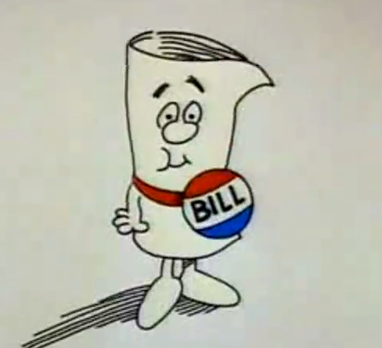
The Birth of a Bill
Someone has an idea.
Idea is taken to legislator’s office for consideration.
Bill is written and assigned a number when it is introduced such as H.B. 1234 or S.B. 123.
Bill referred to House or Senate standing committee to get first committee assignment.
Bills and co-sponsors can be tracked:
Federal: http://thomas.loc.gov
State: http://legislature.mi.gov

Slide 7
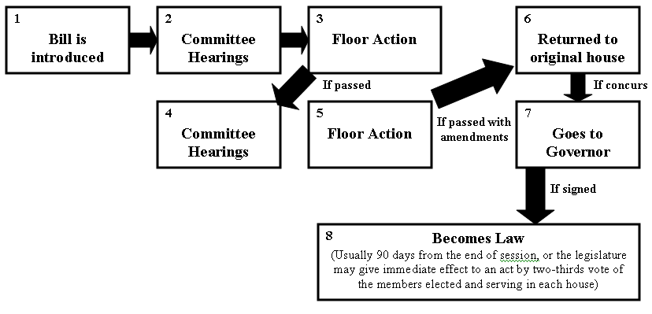
How a Bill Becomes a Law (State)

Slide 8
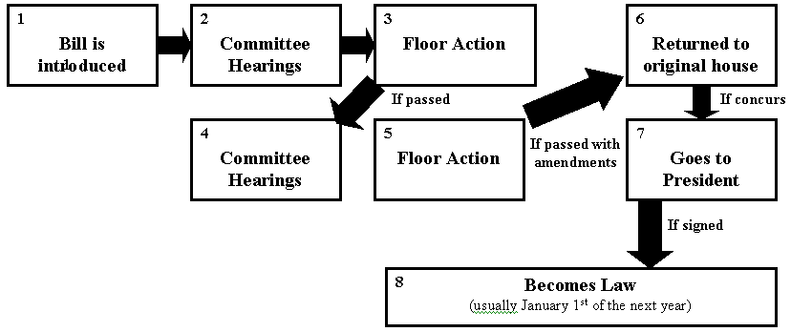
How a Bill Becomes a Law (Federal)

Slide 9
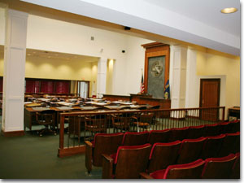
The Committee Process
Hearings are held before a full committee or a subcommittee with jurisdiction over the bill.
Citizens, invited experts, and professionals in Congress often testify on state legislation.
After (or during) hearing, bill may be “marked up,” allowing the committee to amend the bill.
Committee votes on advancing the bill to next committee, or to the floor of the House or Senate.

Slide 10
Knowing the Issues
Some helpful sources:
http://www.hsus.org
http://www.wspa-usa.org
http://www.hslf.org
http://www.michiganpetfund.org
http://mpaw.org/
http://www.dawnwatch.com
http://animalwelfareinstitute.blogspot.com/
http://www.guardian.co.uk/world/animal-welfare
http://www.animallaw.com/
http://www.animallawcoalition.com/
http://www.pet-abuse.com/
Attend club meetings and read meeting minutes to find out about the latest Humane Insight and Legislative Update!

Slide 11
How to Be Active and Have Influence
Call your legislator – quick and effective
Write your legislator – e-mail, fax, letter
Letters to the Editor – create public dialogue
Attend public meetings and ask questions relating to current animal-related issues
Have personal meetings with legislative offices
Lobbying at the Michigan or U.S. capitol

Slide 12
Writing to Legislators
Form letters/e-mails are okay, but personalized letters/e-mails are far more effective.
Short time commitment—usually between 5 to 10 minutes.
Keep it short and concise.
Introduction with 2-3 sentences, body with 1-2 small paragraphs, concluding thoughts in 1-3 short sentences.
Always state the bill name and number at the beginning and end of the letter or e-mail.
Always thank them for their time and consideration.

Slide 13
Calling Legislators
Can call during business hours (usually 9 AM – 5 PM) or after business hours by leaving a voicemail message.
Can ask to speak directly to the legislator or specific staff member or just leave a message with whoever picks up the phone.
Short time commitment—usually between 3 to 5 minutes.
Keep it short and concise.
State who you are, where you’re from, and what you’re calling about (issue or bill), and how you want the legislator to vote (support or oppose).
Always thank them for their time and consideration.

Slide 14
Check out our website’s “Take Action” section for current political action campaigns and our Grassroots Advocate Toolkit for tons of resources!

Slide 15
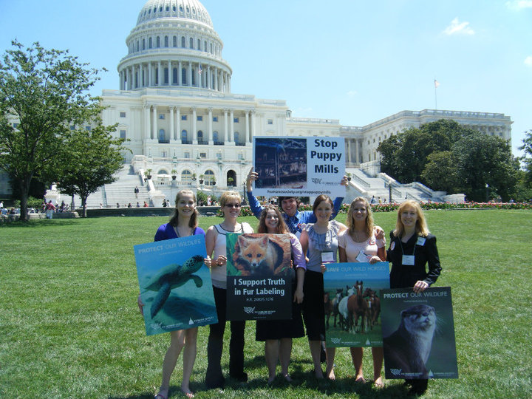
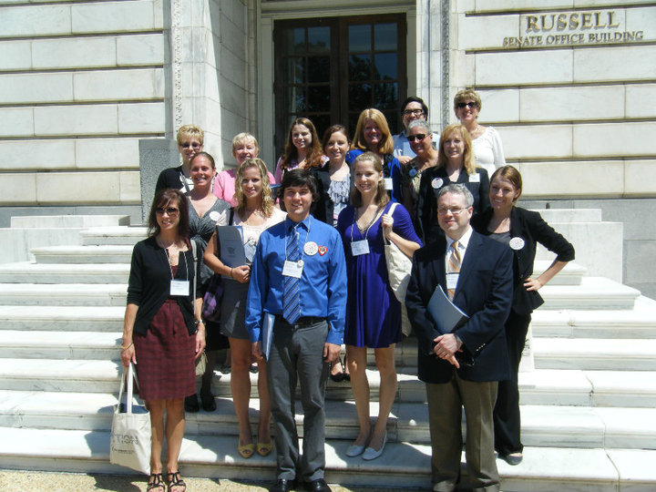
Lobbying
A form of advocacy by individuals, legislators, constituents, or special interest groups with the intention of influencing decisions made by legislators and officials in the government.
More time commitment than writing and calling. A little training is usually needed.
Stay tuned for information on Lobby Days at the state and U.S. capitols!

Slide 16
How to Handle Differing Opinions
Not everyone you speak to will agree with your views on animal-related issues.
Things to remember:
Certain issues are more controversial.
Just because someone disagrees or is ill-informed does not mean he/she is a bad person.
Always listen and be respectful.
Smile.
Educate, don’t dictate or judge.
Discuss an issue by taking different approaches: health, environment, economic, humane aspect, etc.
Always thank whoever you are speaking to for his/her time and consideration.

Slide 18
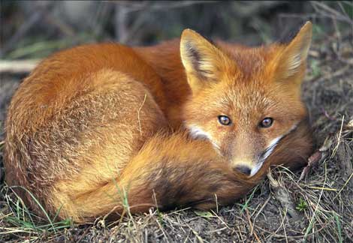
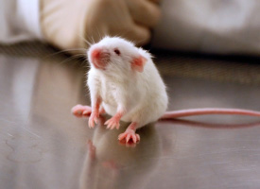
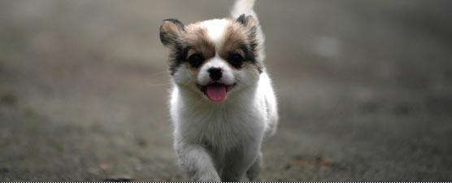
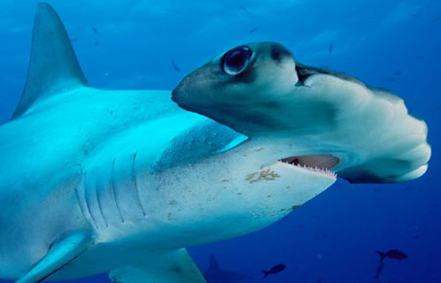
Now Let’s Take Some Action for Animals!

